Slide 1

Coven labs data science project ON R
BENIN COHORT 5
R GROUP 3

Slide 2
SOLVING THE CHALLENGE OF PRE-ECLAMPSIA AND ECLAMPSIA IN THE MOST VULNERABLE PREGNANT WOMEN
PROBLEM STATEMENT: To find the relationship between age, number of pregnancies and blood pressure of diabetic pregnant women and their risk of having pre-eclampsia(hypertension in pregnancy) and eclampsia(a result of hypertension in pregnancy)

Slide 3
Introduction: Pregnancy comes with many twists and turns, some of which are not so pleasant. others, even life threatening to both mother and unborn child. Diabetes in pregnant women could be of unknown etiology or gestational(occurring during pregnancy) and can have far reaching consequences.

Slide 4
Hypertension, like diabetes in pregnancy could also be of unknown etiology or associated with pregnancy. Ironically, each of these diseases serve as risk factors for the other. Hence the relevance of this study

Slide 5
Data source: Data for 768 diabetic pregnant Indian women were obtained from www.kaggle.com

Slide 6
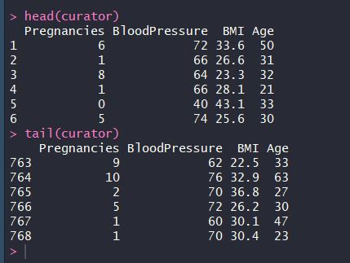
BRIEF REVIEW OF DATA SET

Slide 7
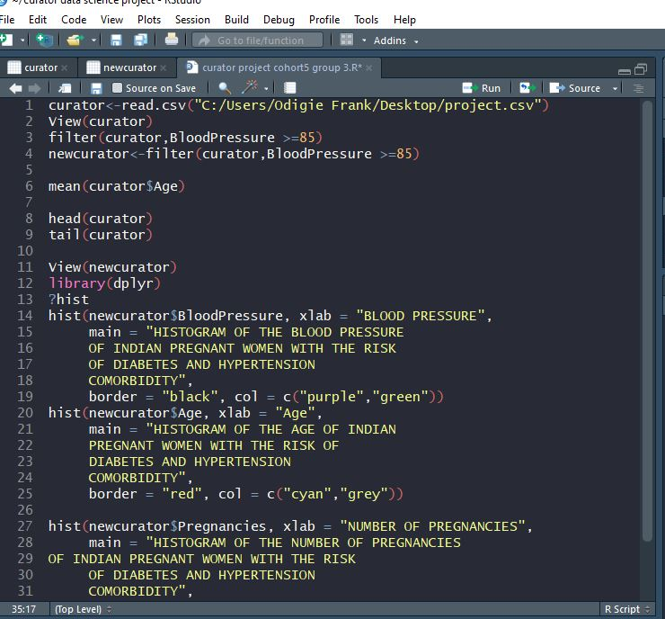
BRIEF OF THE DATA WRANGLING PROCESS

Slide 8
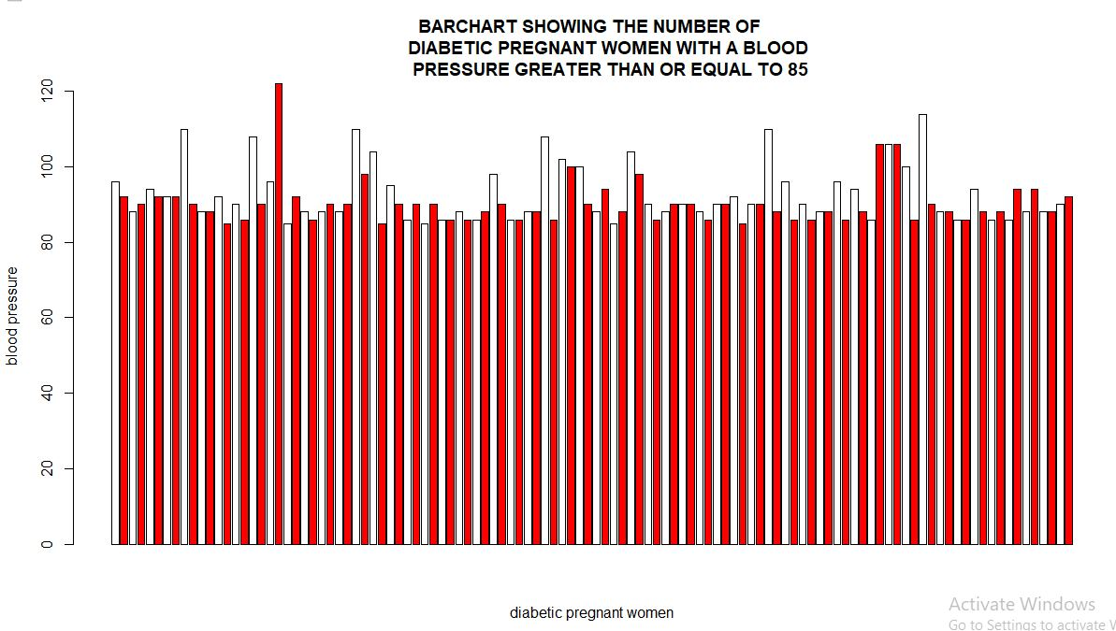
112 women having blood pressure greater than 85 were in this category with an average age of 37

Slide 9
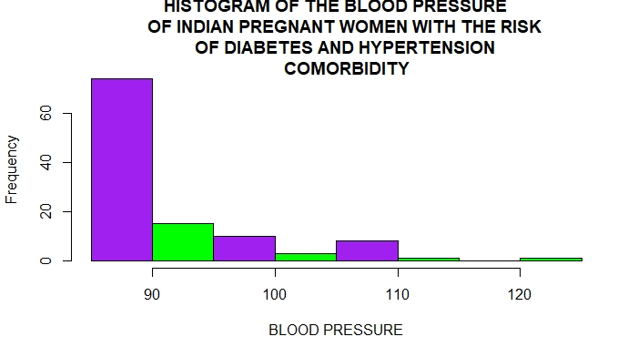

Slide 10
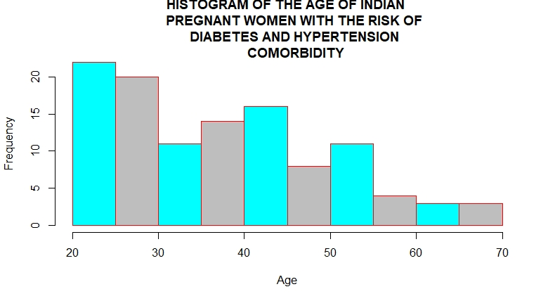

Slide 11
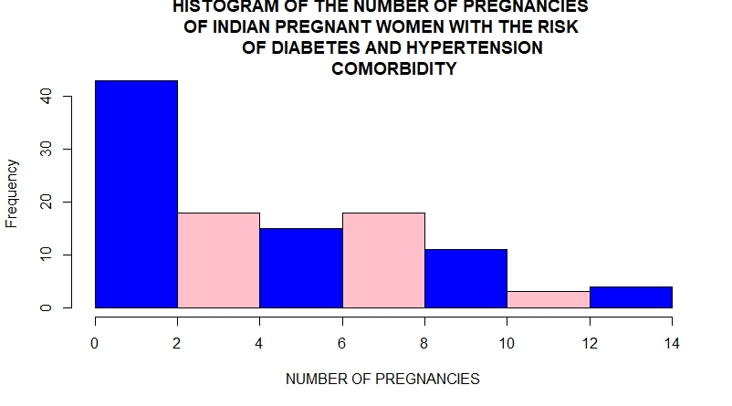

Slide 12
Summary: The above data shows that women between age 20-30yrs and with fewer pregnancies had a higher risk of being hypertensive and thus a higher risk of eclampsia(seizures due to high blood pressure) and its complications.

Slide 13
Recommendations: To prevent the complications that pre-eclampsia and elcampsia can result in for both mother and child, a close monitoring of the blood pressure of diabetic women within 20-30yrs of age and with fewer previous pregnancies is highly recommended

Slide 14
Thank you for listening

